Slide 1
Applied Database III
Yan Puspitarani

Slide 2

Grup LINE

Slide 3
CPMK
Setelah menyelesaikan matakuliah ini, mahasiswa semester 7 dapat menyelesaikan kasus-kasus terkait data mining

Slide 4
Matkul prasyarat
Applied Database I
Applied Database II

Slide 5
Matkul Dasar
Algoritma dan Struktur Data
Statistika Dasar
Kecerdasan Buatan
Sistem Basis Data

Slide 6
Referensi
Jiawaei Han, Michelle Kamber, Data Mining Concept and Techniques, 2nd Edition, McGraw-Hill, 2006.
Pang NIng Tan, Introduction to Data Mining
Related Books
Related Journals
Related Software and Tools Data Mining

Slide 7
Aturan Perkuliahan
Perkuliahan dilaksanakan secara online melalui kuliahonline.widyatama.ac.id
Tatap muka melalui zoom meeting atau google meet dilakukan berdasarkan kesepakatan pada pertemuan non-praktikum
Tatap muka di kelas dilakukan ketika praktikum
Segala informasi akan diinfokan melalui grup Line/WhatsApp
Tidak ada toleransi keterlambatan pengumpulan tugas/quiz
Akses quiz hanya dibuka 24 jam
Akses Tugas hanya dibuka sampai H-2 perkuliahan pertemuan berikutnya. Jika terlewat, tidak akan bisa submit

Slide 8
Komponen Penilaian
10 % kehadiran,
25% UTS, mengerjakan soal kasus
25% UAS, mengerjakan soal kasus
40% Tugas , ada project Tugas Besar

Slide 9
Materi
Pendahuluan Data Mining
Jenis-jenis Data
Data Preprocessing
Classification
Association Analysis
Sequence & Graph Mining
Clustering
Anomaly Detection

Slide 10
Penunjang Mata Kuliah untuk Praktikum
Weka
Rapid Miner
Python
Aplikasi Data Mining lain

Slide 11
Materi Kuliah Hari ini
Data
Konsep Data Mining
KDD
Task Data Mining

Slide 12
Capaian Pembelajaran materi hari ini
Setelah menyelesaikan materi hari ini, diharapkan mahasiswa mampu menjelaskan teori dan konsep data mining

Slide 13
Data Mining
Pertemuan 1
Yan Puspitarani

Slide 14
Perhatikan...
Look up phone number in phone directory
Query a Web search engine for information about “Amazon”
Certain names are more prevalent in certain US locations (O’Brien, O’Rurke, O’Reilly… in Boston area)
Group together similar documents returned by search engine according to their context (e.g. Amazon rainforest, Amazon.com,)

Slide 15
What is Data Mining?
Non-trivial extraction of implicit, previously unknown and potentially useful information from data
Knowledge Discovery in Databases (KDD)

Slide 16

Knowledge Discovery in the old days
Observe phenomena
Formulate theory
Validate theory via experimentation
From: http://csep10.phys.utk.edu/astr161/lect/history/newtongrav.html

Slide 17

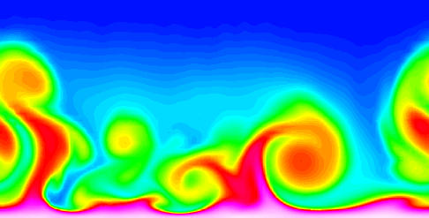
Nowadays…
Data,
Data
Everywhere
Lots of data
Lack of theory
Data mining can help to generate new hypothesis or help analysts to make sense out of the data

Slide 18
What is (not) Data Mining?
What is not Data Mining?
  Look up phone number in phone directory
  Query a Web search engine for information about “Amazon”
What is Data Mining?
  Certain names are more prevalent in certain US locations (O’Brien, O’Rurke, O’Reilly… in Boston area)
  Group together similar documents returned by search engine according to their context (e.g. Amazon rainforest, Amazon.com,)

Slide 19
Data Mining Tasks
Predictive Methods
  Use some variables to predict unknown or values of other variables.
Descriptive Methods
  Find human-interpretable patterns that describe the data.
From [Fayyad, et.al.] Advances in Knowledge Discovery and Data Mining, 1996

Slide 20
Data Mining Tasks...
Classification [Predictive]
Clustering [Descriptive]
Association Rule Discovery [Descriptive]
Sequential Pattern Discovery [Descriptive]
Regression [Predictive]
Anomaly Detection [Predictive]

Slide 21
Classification: Definition
Given a collection of records (training set )
  Each record contains a set of attributes, one of the attributes is the class.
Task: Find a model for class attribute as a function of the values of other attributes.
Goal: previously unseen records should be assigned a class as accurately as possible.
  A test set is used to determine the accuracy of the model. Usually, the given data set is divided into training and test sets, with training set used to build the model and test set used to validate it.

Slide 22
Classification Example
categorical
categorical
continuous
class
Test
Set
Learn
Classifier
Training
Set
Model

Slide 23
Clustering Definition
Given a set of data points, each having a set of attributes, and a similarity measure among them, find clusters such that
  Data points in one cluster are more similar to one another.
  Data points in separate clusters are less similar to one another.
Similarity Measures:
  Euclidean Distance if attributes are continuous.
  Other Problem-specific Measures.

Slide 24
Illustrating Clustering
Euclidean Distance Based Clustering in 3-D space.
Intracluster distances
are minimized
Intercluster distances
are maximized

Slide 25
Association Rule Discovery: Definition
Given a set of records each of which contain some number of items from a given collection;
  Produce dependency rules which will predict occurrence of an item based on occurrences of other items.
Rules Discovered:
{Milk} --> {Coke}
{Diaper, Milk} --> {Beer}

Slide 26
Sequential Pattern Discovery: Definition
Given is a set of objects, with each object associated with its own timeline of events, find rules that predict strong sequential dependencies among different events.
Rules are formed by first disovering patterns. Event occurrences in the patterns are governed by timing constraints.
(A B) (C) (D E)
(A B) (C) (D E)
<= xg
>ng
<= ws
<= ms

Slide 27
Regression
Predict a value of a given continuous valued variable based on the values of other variables, assuming a linear or nonlinear model of dependency.
Greatly studied in statistics, neural network fields.
Examples:
  Predicting sales amounts of new product based on advetising expenditure.
  Predicting wind velocities as a function of temperature, humidity, air pressure, etc.
  Time series prediction of stock market indices.

Slide 28
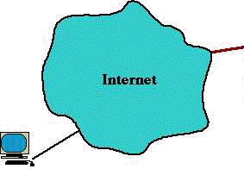
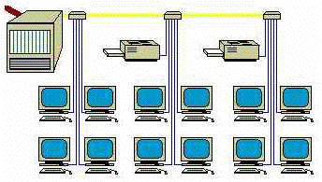
Deviation/Anomaly Detection
Detect significant deviations from normal behavior
Applications:
  Credit Card Fraud Detection
  Network Intrusion
  Detection
Typical network traffic at University level may reach over 100 million connections per day

Slide 29
Tugas
Diskusikan dengan temanmu, aplikasi-aplikasi apa saja yang memanfaatkan data mining. Kemudian jelaskan aplikasi tersebut serta task data mining yang digunakan! Tiap mahasiswa harus menyebutkan 1 aplikasi beserta deskripsinya.
Laporkan hasil temuannya pada pertemuan 2 !

